Slide 1
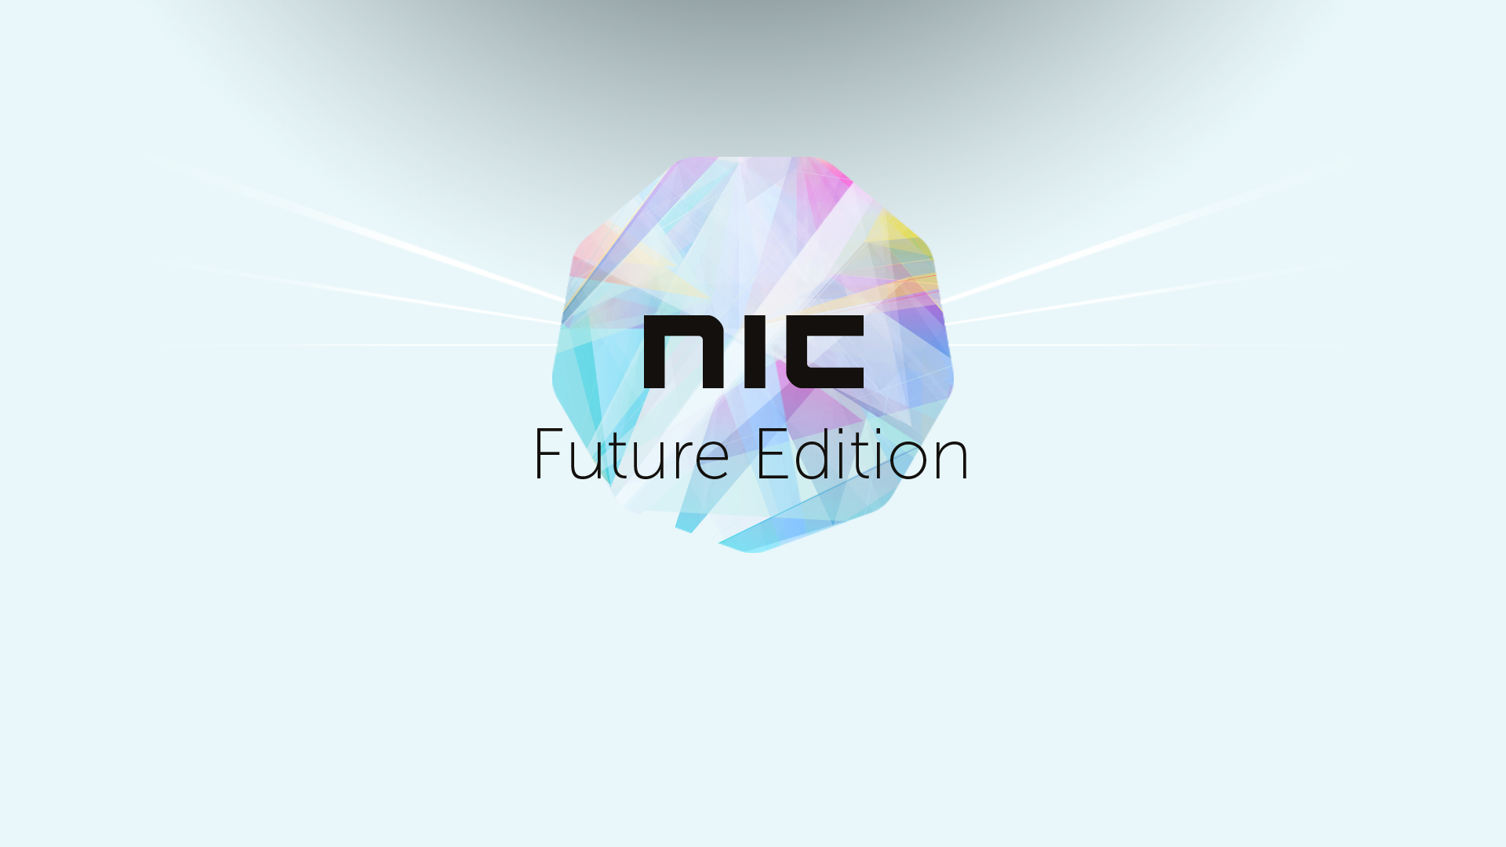

Slide 2

Be the automator - not the automated
Jan Egil Ring | Microsoft MVP
@JanEgilRing

Slide 3

Agenda
Intro
Being a modern IT Pro
Tooling
PowerApps
Logic Apps
Sharepoint
Azure Automation
Demo
Automated user on/offboarding
Notes:
A key aspect of the modern DevOps and digital transformation era is automation. It plays a key role and is an important skill to master for the modern IT Pro. In this session we will look at some key concepts around DevOps and tooling before diving into demos showing examples on what processes and tools can be used for automation based on real world experiences. Azure Automation, Azure Logic Apps and Microsoft PowerApps is some of the technologies you will get to see in this session.

Slide 4








Continuous Management
.
COST
POLICY
SUBSCRIPTION
DEVOPS TOOLING
PACKAGING
GOVERN
BUILD
& RELEASE
SECURE
DevOps
DETECT
PREVENT
ORCHESTRATION
PATCHING
CONFIGURE
CONFIG MONITORING
PowerShell
PROTECT
MONITOR
BACKUP
RECOVERY
ANALYTICS
DISCOVERY
ALERTS

Slide 5




DevOps lifecycle
1
4
Plan
Monitor + Learn
Development
Operations
2
3
Develop + Test
Release
Notes:
BRK3129 - Manage hybrid cloud and transform your workplace with PowerShell and Azure Automation

Slide 6


Demo - DevOps scenario in hybrid world
Application requirements
Operational requirements
Source Control
Manage Builds Test coverage
Approve releases
Operations
Developer
App monitoring
VS Team services Azure templates
Azure Automation DSC Azure Automation runbooks
Cloud shell PowerShell
Infrastructure monitoring
Business insight
Secure deployment / access
Application tests
Backup / recovery
Operational &Application requirements
Operational &Application requirements
Azure / Other public clouds
On-premises

Slide 7
Scenario
Automated user on/offboarding
Frontend: PowerApps
Data store: Sharepoint list
Trigger/workflow engine: Azure Logic Apps
Automation engine: Azure Automation & PowerShell

Slide 8

PowerApps
Notes:
BRK2098 - Deliver sophisticated apps in days - Learn how PowerApps can transform your business

Slide 9

Cloud-first
Cross-platform
Connected
Centrally manageable
“No cliffs”
PowerApps

Slide 10

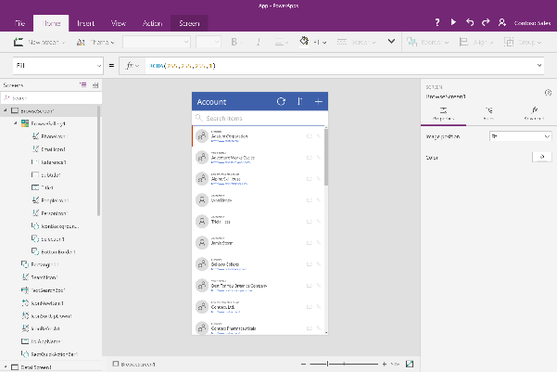
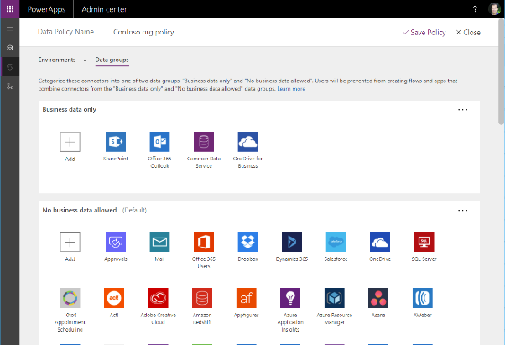
Easy Authoring
Truly WYSIWYG – full control over user experience, use it as you build it
Create app logic with familiar Excel-like expressions
Mash up data from multiple sources right at the app level

Slide 11
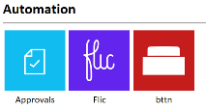
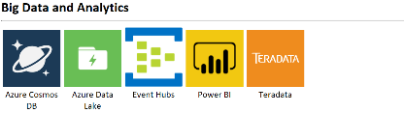
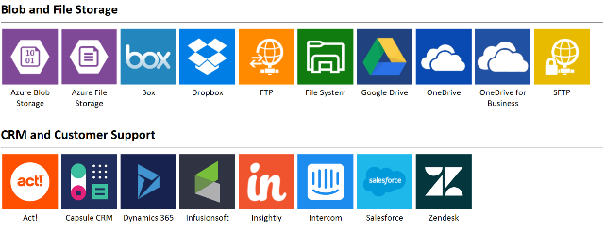
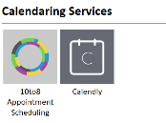
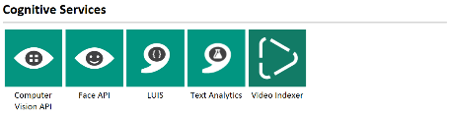
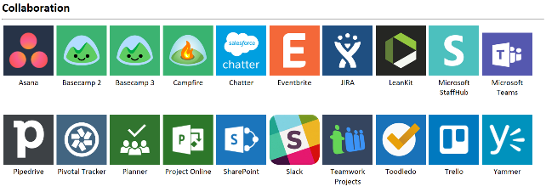
Connected data
Common data service provides a rich platform + standard model that gets creators instantly productive
Add 160+ connected data sources
Add custom connectors and on-premises sources

Slide 12
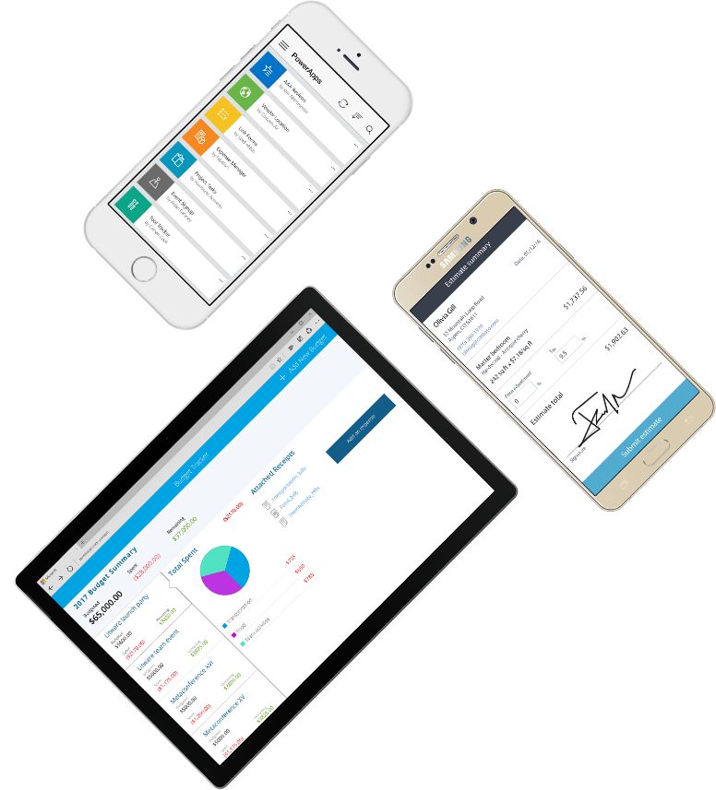
Cross-platform
Publish instantly to iOS, Android, Windows, and the web
Sharing apps is like sharing documents
Manage across environments

Slide 13

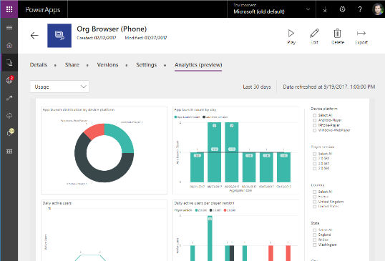


Enterprise Ready
Centrally view app telemetry and manage apps
Set DLP policy on data and connectors
Compliance with 13+ standards inc. HIPAA, EU Model Clauses & SOC

Slide 14

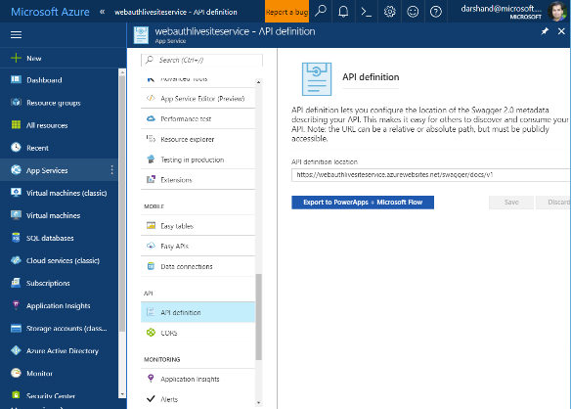

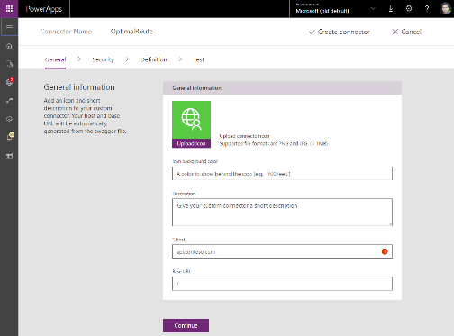
Pro developers welcome…
Build apps that go beyond what you get in the box
Build reusable custom app components & connectors
Leverage the full power of Azure capabilities

Slide 15
WHO CREATES APPS?
“Makers” on your team
Departmental IT
Corporate IT
Partners

Slide 16
FOR WHAT SCENARIOS?
Customize and extend existing apps
Mobile worker scenarios (e.g., inspection)
Mash up multiple sources
Focused task-based experiences

Slide 17
Office 365
Dynamics 365
Azure
Power BI
PowerApps
Microsoft Flow
Common Data Service
Connectors + gateways

Slide 18
Demo
PowerApps

Slide 19

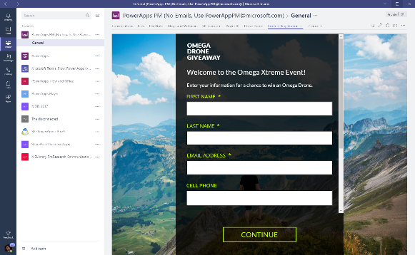

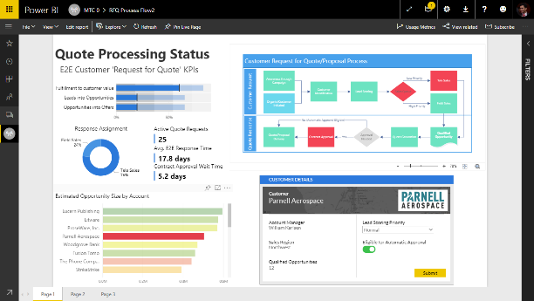
PowerApps everywhere
Easily publish and share PowerApps within an organization
Embed PowerApps in Microsoft Teams
Embed PowerApps in Power BI dashboards

Slide 20
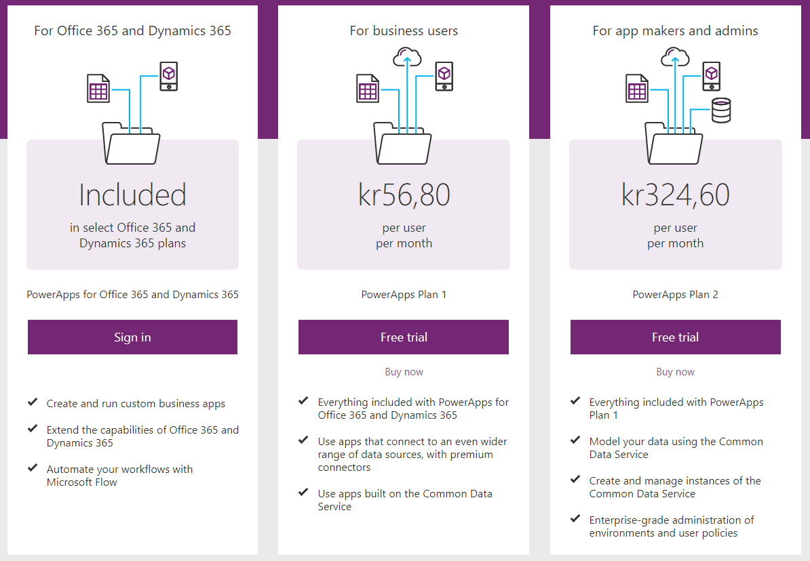
Pricing
Notes:
https://powerapps.microsoft.com/nb-no/pricing/
Common Data Service
Data storage in the Common Data Service (per user) Use premium connectors like Salesforce, DB2

Slide 21

SharePoint PowerApps & Flow

Slide 22
Demo
Sharepoint list

Slide 23
Azure Logic Apps

Slide 24
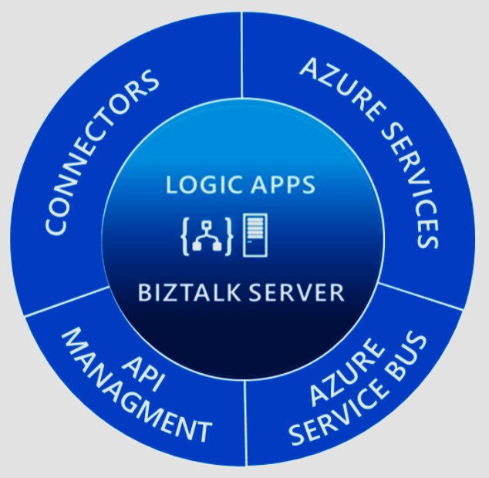
Integration.
Evolved.
Hybrid
API First
Connect Everything
Gain Insights

Slide 25

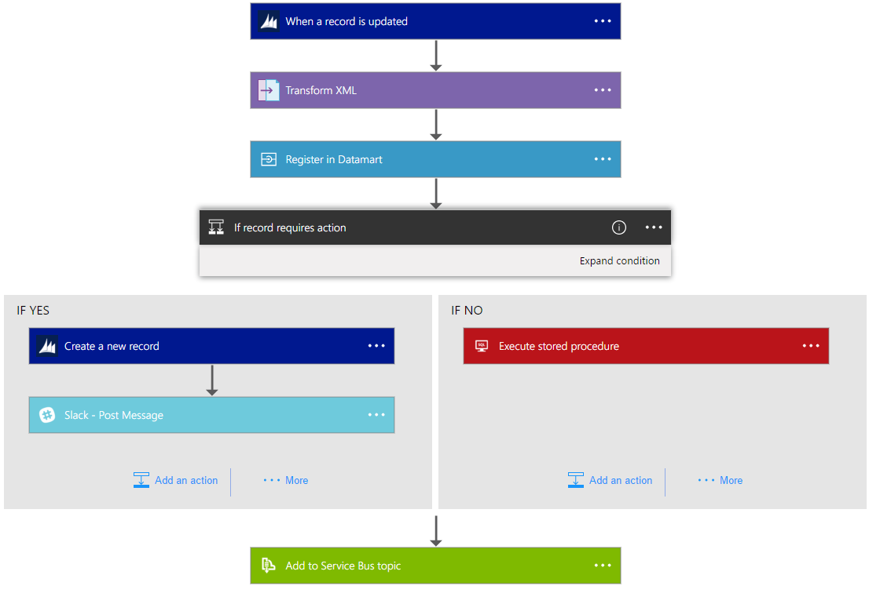
Logic Apps is Powerful Integration
Hyperscale Workflow Engine, born in Azure
Faster integration using innovative Visual Designer
Easy workflow creation with triggers and actions
Mashup applications, data and services
Built for mission critical Enterprise Integration
Create, deploy, manage and monitor

Slide 26
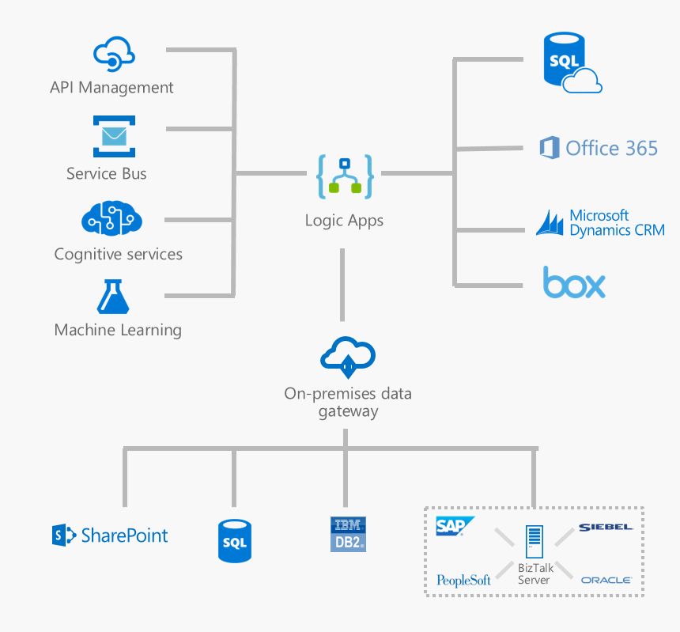

Microsoft's
Hybrid
Integration Platform
Connect on-premises, hybrid and cloud applications
Run mission-critical, complex integration scenarios with ease
Enhance business productivity by automating business processes where it makes sense, on-premises or in Azure
Build “Smart” Integrations leveraging Machine Learning/Cognitive Services

Slide 27
Logic Apps is Serverless
Reduced devops
Reduced time to market
Per action billing

Slide 28

SaaS
10to8
Act!
Adobe Creative Cloud
appFigures
Asana
Azure Active Directory
Azure API Management
Azure App Services
Azure Application Insights
Azure Automation
Azure Cognitive Face API
Azure Cognitive LUIS
Azure Cognitive Text Analytics
Azure Cognitive Vision
Azure Data Lake Store
Azure Document DB
Azure Event Hubs
Azure Event Grid
Azure Files
Azure Functions
Azure Machine Learning
Azure Resource Manager
Azure Service Bus
Azure SQL
Azure Storage Blob
Azure Storage Queues
Basecamp2&3
Benchmark Email
Bing Maps
Bing Search
BitBucket
Bitly
Blogger
XML
XML Validation
Transform XML (+Mapper)
Flat File Encode
Flat File Decode
Int Account Artifact Lookup
EDI
X12
EDIFACT
AS2
Protocol/
Native
Batching
HTTP, HTTPS
HTTP Webhook
FTP, SFTP
SMTP
RSS
Compose, Parse JSON
Query, Join, Table, Select
Schedule, Wait
Terminate
Workflow
Hybrid
BizTalk Server
File System
IBM DB2
Informix
Oracle DB
MySQL
PostgreSQL
SharePoint Server
SQL Server
SAP
Teradata
Websphere MQ
Box
Buffer
Calendly
Campfire
CapsuleCRM
Chatter
Cognito Forms
Common Data Service
Disqus
DocuSign
Dropbox
Dynamics CRM Online
Dynamics CRM Service Bus
Dynamics for Financials
Dynamics for Operations
Dynamics NAV
Easy Redmine
Elastic Forms
Eventbrite
Facebook
FreshBooks
Freshdesk
FreshService
GitHub
Gmail
Google Calendar
Google Contacts
Google Drive
Google Sheets
Google Tasks
GoTo Meeting
GoTo Training
GoTo Webinar
Harvest
HelloSign
HipChat
Infusionsoft
Inoreader
Insightly
Instagram
Instapaper
Intercom
JIRA
JotForm
LeanKit
LiveChat
MailChimp
Mandrill
Microsoft Forms
Microsoft Teams
Microsoft Translator
Medium
MSN Weather
Muhimbi PDF
Nexmo
Office 365
Office 365 Users
Office 365 Video
OneDrive
OneDrive for Business
OneNote
Outlook.com
Outlook Customer Manager
Outlook Tasks
Paylocity
PagerDuty
Parserr
Pinterest
Pipedrive
Pivotal Tracker
Planner
Power BI
Project Online
Redmine
Salesforce
Salesforce Chatter
SendGrid
SharePoint Online
Slack
SmartSheet
SparkPost
Stripe
Survey Monkey
Teamwork
Teradata
Todoist
Toodledo
Trello
Twilio
Twitter
Typeform
UserVoice
Vimeo
VS Team Services
Webmerge
Wordpress
Wunderlist
Yammer
YouTube
Zendesk
Cloud APIs and platform functionality
To your services, apps, LOB systems
Hosted and managed within the platform
Scales to meet your needs
First class designer experience
Rapid development
API connections
Authenticate once and reuse
Differentiate connection configuration
Simple to deploy
Portal experience for managing API Connections
Notes:
Over 160 built-in connectors

Slide 29
Monitoring
Trigger & Run History
Monitoring view
Diagnostics
Alerts

Slide 30
Tracking
Tracked properties
Operations Management Suite
Tracking API
Enable diagnostic logging
Notes:
OMS Integration available

Slide 31
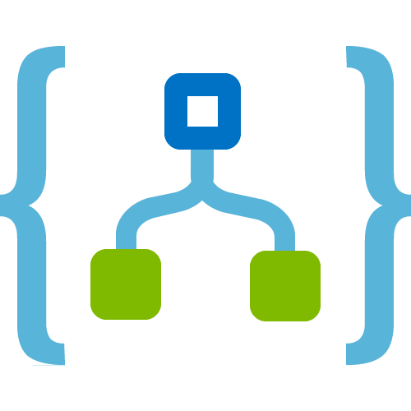










Easy Hybrid Integration
On-premises Data Gateway
Azure API
Management
Azure Service Bus
Logic Apps
Logic Apps
Logic Apps
On-premises data gateway for rich data and application integration
Azure API Management for SOAP and backend APIs
Service Bus for cross platform support
GatewayCloud Service
APIM
Azure Service Bus relay
Virtual network or public
Queues
Topics
Gateway
Data Sources
LOB
Systems
SOAP web services
Backend
APIs
API-based

Slide 32





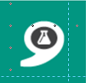


Better Together.
Logic Apps
Service Bus
3rd Party
Sources
Computer
Vision
BizTalk
Server 2016
API
Management
Text
Analytics
Face API
Functions
Limitless Possibilities

Slide 33
Demo
Logic Apps

Slide 34
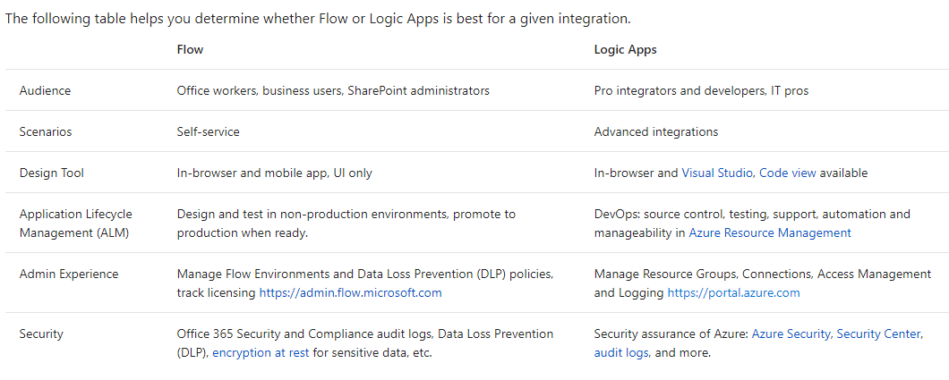
Microsoft Flow vs Logic Apps
Notes:
https://docs.microsoft.com/en-us/azure/azure-functions/functions-compare-logic-apps-ms-flow-webjobs
Flow: Runbooks will start in the context of the end user
Logic Apps: Runbooks will start in the context of the specified sevice connection

Slide 35
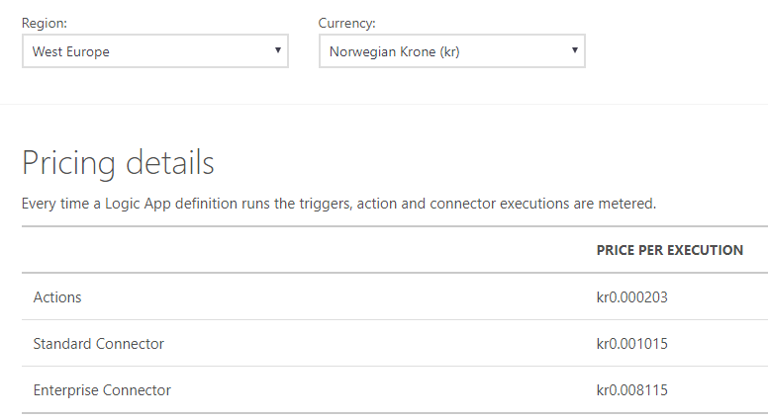
Pricing

Slide 36

Automation & Configuration
Key Features
Manage any cloud & on premises
Windows & Linux
Configuration Management
Process Automation
Update Management
Configuration Management
DSC Configurations, Pull service
Node Management & Reporting
Change tracking & Inventory
Process Automation
Author runbooks - PowerShell, scripts PowerShell workflow, Graphical, Python2
Hybrid Runbook Workers with Proxy support
Update Management
Insights across your hybrid environment
Orchestrated updates and troubleshooting
Easy Onboarding
RunAs account for Azure management
Gallery of runbooks and modules from Microsoft and community
Shared capabilities across features
Role Based Access Control
Secure, global store for variables, credentials, certificates, connections
Schedules
Modules
Source control support
Auditing
Tags
Integration
Included with Azure SDK
Webhooks to start runbook remotely
Azure
Any Cloud
Automation & Config
Hybrid Worker
On-Premises
Hyper-V
VMWare
OpenStack
Reliable, highly available, scalable
Hybrid management Integrate existing systems

Slide 37
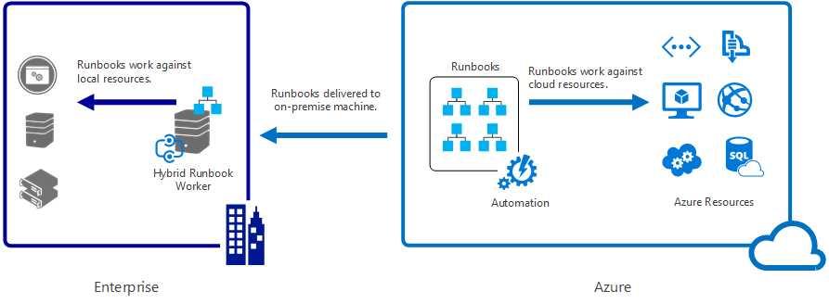
Hybrid Workers
cd "C:\Program Files\Microsoft Monitoring Agent\Agent\AzureAutomation\<version>\HybridRegistration"
Import-Module HybridRegistration.psd1
Add-HybridRunbookWorker –Name <String> -EndPoint <Url> -Token <String>
Notes:
No VPN
The Hybrid Worker Agent is continuously listening for new job requests

Slide 38
Demo
Azure Automation

Slide 39
Flow chart Automated user on/offboarding
PowerApps
Logic Apps
Sharepoint
Azure Automation

Slide 40
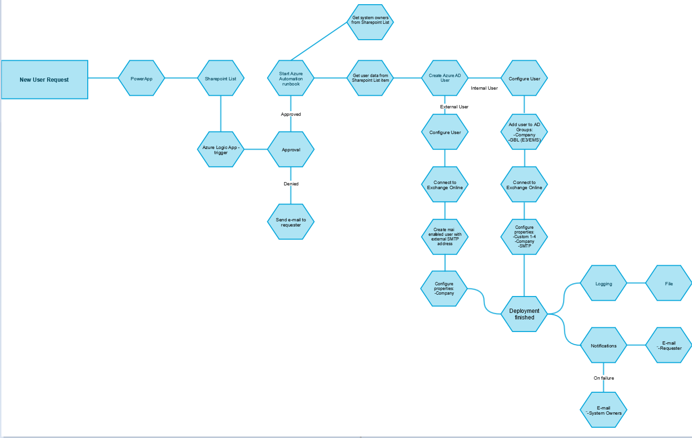
Notes:
Bruker starter «New Employee» Logic App via mobil eller PC
Nytt element legges inn i en Sharepoint-liste med all nødvendig info om ny bruker
En Logic App sjekker denne lista etter nye elementer hvert 3. minutt
Når Logic App starter vil det gå en Approval melding til definert person
Blir godkjennings-forespørsel akseptert vil en Azure Automation runbook trigges
Runbooken leser info fra Sharepoint-lista og oppretter ny bruker

Slide 41
Sessions from Ignite 2017
PowerApps
BRK2098 Deliver sophisticated apps in days: Learn how PowerApps can transform your business Ryan Cunningham and Ankit Saraf
BRK3348 Create custom forms and digital experiences in SharePoint using Microsoft PowerApps Cathy Dew and Wes Preston
BRK4037 Deep dive: Take Microsoft PowerApps customization to the next level with advanced expressions Greg Lindhorst
BRK3342 Connect Dynamics 365 and business application data with Common Data Service for powerful results Jono Luk
Microsoft Flow
BRK2306 Automate workflows and enable modern approvals with Microsoft Flow Anjli Chaudhry
BRK4040 Deep dive: Advanced workflow automation with Microsoft Flow Stephen Siciliano
BRK3359 Deep dive: Compare SharePoint Designer and Microsoft Flow scenarios Merwan Hade
BRK3341 Unlock extensibility by connecting your service to PowerApps and Microsoft Flow Theresa Palmer and Sunay Vaishnav
Common
GS06 Transform your business with the Business Application Platform Frank Weigel and Kees Hertogh
BRK2224 Transform business process with SharePoint, PowerApps, and Flow for biz apps, forms, and automation Chris McNulty, Robert Burg, Kerem Yuceturk
BRK2305 Administration and ALM best practices for PowerApps, Microsoft Flow and Common Data Service James Oleinik
BRK2154 Real world use cases: Custom solutions build with PowerApps, Microsoft Flow & Common Data Service Saurabh Pant and Pratap Ladhani

Slide 42
Resources
Azure Automation documentation: https://docs.microsoft.com/en-us/azure/automation
Logic Apps Documentation: http://aka.ms/logicapps-docs
Logic Apps Blog: http://aka.ms/logicappsblog
Logic Apps Monthly Webcast: http://aka.ms/logicappslive
PowerApps documentation: https://docs.microsoft.com/en-us/powerapps

Slide 43

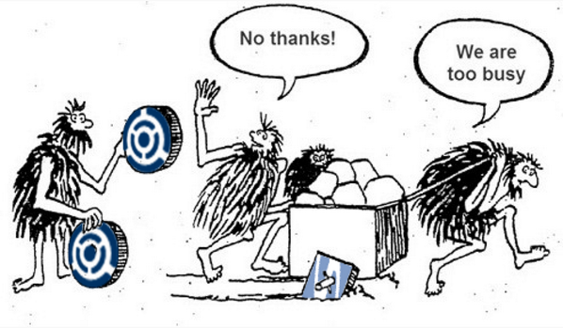
Key takeaways

Slide 44
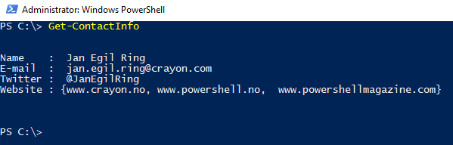
Contact info
Thank you!
Notes:
function Get-ContactInfo {
[pscustomobject] @{
Name = ' Jan Egil Ring '
'E-mail ' = ' jan.egil.ring@crayon.com'
Twitter = ' @JanEgilRing '
Website = @('www.crayon.no', 'www.powershell.no'
' www.powershellmagazine.com')
} | Format-List
}
Get-ContactInfo

Slide 45
Backup content

Slide 46
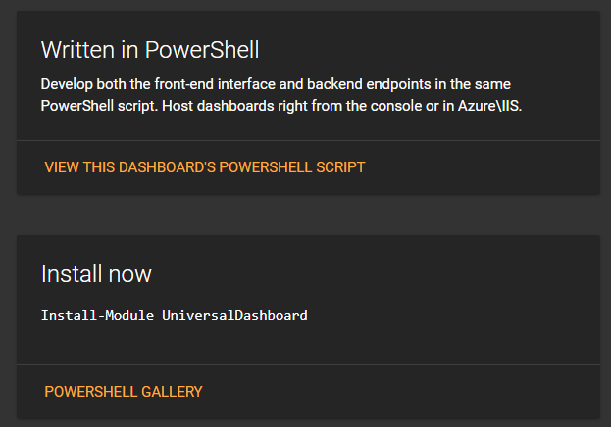
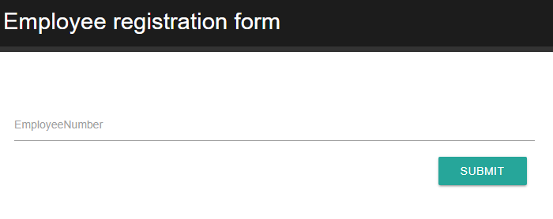
PowerShell Universal Dashboard
Universal Dashboard is a cross-platform PowerShell module for developing and hosting web-based, interactive dashboards.
Leveraged in user on/offboarding process for registration in external system which couldn`t be automated
http://www.poshud.com

Slide 47
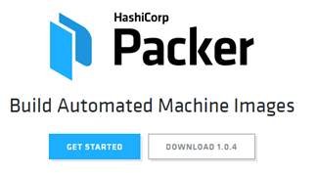
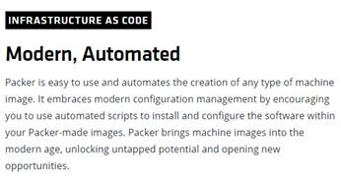
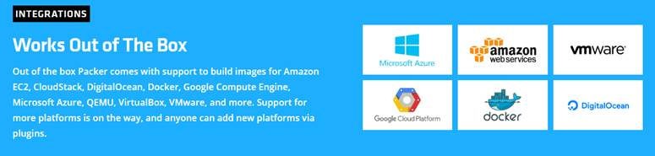
Notes:
Backup demo (if time allows)
I et nøtteskall er det en exe-fil (packer.exe) som pekes til en konfig-fil som utfører jobben med å spinne opp en VM, patche og kjøre kommandoer som spesifisert i konfig-fila før den eksporterer VM`en til en VHDX-fil som kan importeres i VMM/Azure. Til slutt slettes den midlertidige VM`en.
Blant fordelene med å bruke dette:
Konfig-fil kan legges i kildekontroll så man vet nøyaktig hvordan et referanse-image er bygd
Det kan scheduleres til å kjøres f.eks. ukentlig slik at man alltid har oppdaterte image å tanke fra
Man får brukt nøyaktig samme image lokalt og i sky

Slide 48
Demo

